Slide 1
You're reviewing a passage with new adult learners, and you realize a few learners struggle with long words.
You wish you had a fast way to customize to their needs.
You also wish your program had a mechanism to observe and support you as you progress in teaching the components of reading.

Slide 2
Today’s Agenda
In our small amount of time together my goal is to make a big impact in the following ways-
Confidence where there was once uncertainty in evidence-based reading instruction.
Clarity where there was once confusion in determining phonics gaps.
To unlock within you the true potential you have to make your dent in the adult ed universe!

Slide 3
Vocabulary
Phonemic Awareness- Phonemes are the smallest units of sound in spoken language, so phonemic awareness is the ability to detect those units within words. Phonemic awareness can develop without written words.
Synthetic phonics - Learners are taught the letter-sound correspondences and then taught to blend the sounds to identify words. In synthetic phonics, students blend individual letter sounds together to form words (e.g., c-a-t/cat).

Slide 4
Analytic phonics-Learners do not pronounce the sounds in isolation, instead they analyze the sounds in a word that is already identified, by word sorting. Words Their Way is an example. In analytic instruction, students compare words to identify patterns and apply this knowledge to new words (e.g., ran/can), or they examine word families to make analogies between.
Systematic phonics

Slide 5
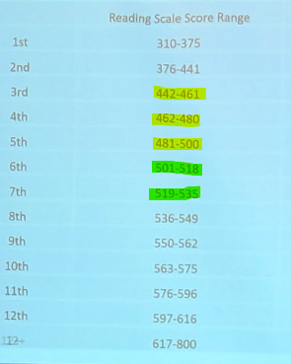
64% of our new students assessed this year in TABE reading are NRS levels 2-3
NRS Level 1 - 0
NRS Level 2 -18
NRS Level 3 - 27
NRS Level 4/5/6 - 25
NRS 2
NRS 3
Is the data at your organization similar?
TABE estimated grade ranges

Slide 6
Greatest Pain Points
Inconsistent reading outcomes
Challenge of aligning instruction with the science of reading
Lack of actionable feedback to help teachers grow

Slide 7
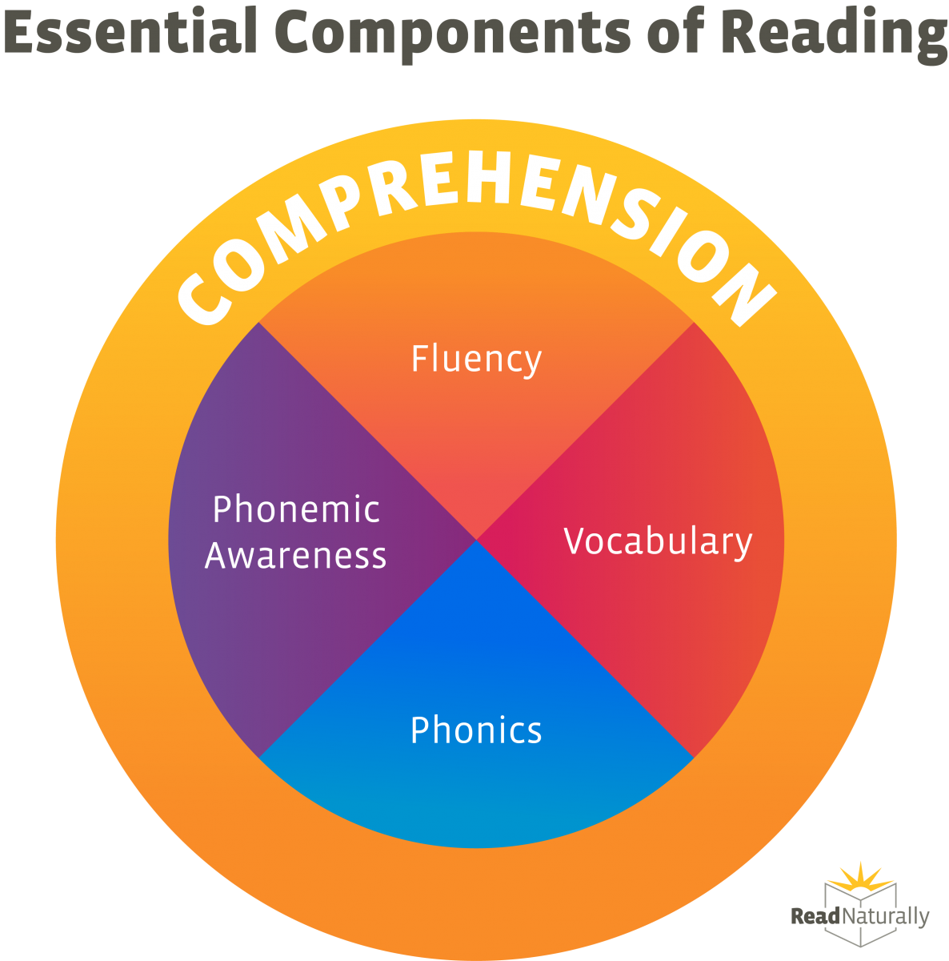

Slide 8
What steps can we take to eliminate these pain points?
Inconsistent reading outcomes
Challenge of aligning instruction with the science of reading
Lack of actionable feedback to help teachers grow

Slide 9
Using the EBRI observation tool could be a solution to these issues.

Slide 10
Look at the EBRI Observation tool
https://drive.google.com/file/d/1MZHjFm5ZhNM9eGgcMMdlU4Jbq8PpmqEZ/view
Where do you feel confident?
What is confusing or unknown to you?

Slide 11
Notes on observations
Use the EBRI observation tool only for good.
for lead- to- teacher, peer- to- peer, or teacher- to- lead
to identify strengths and areas for growth
and share strategies!
Progress not perfection.

Slide 12
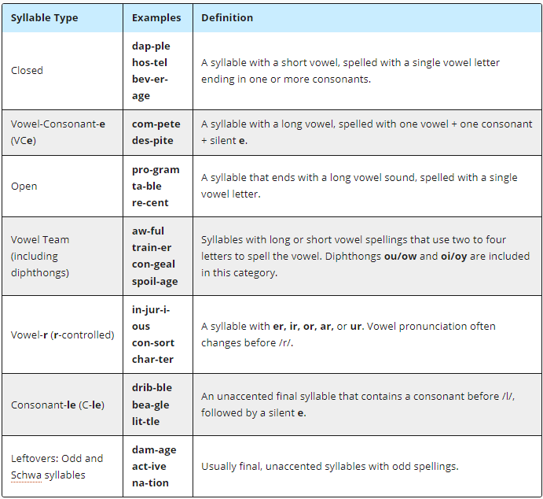
Six syllable types
(https://www.readingrockets.org/topics/spelling-and-word-study/articles/six-syllable-types)
LINK

Slide 13
Diphthong: Dynamic glide between two sounds boil and cow
Vowel Digraph: Single sound from two vowels (e.g., in boat).

Slide 14
More about digraphs
A digraph is a combination of two letters that together represent a single sound (phoneme). For example:
In "ch" (as in chip), the two letters "c" and "h" combine to make the /ch/ sound.
In "th" (as in this or thin), the "t" and "h" create the /th/ sound.
In "sh" (as in ship), the "s" and "h" form the /sh/ sound.
Digraphs can represent both consonant and vowel sounds, such as in the vowel digraph "ea" (as in seat), which represents the long /e/ sound.

Slide 15
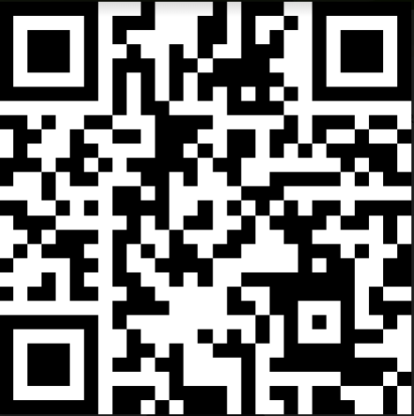
Resources from today’s presentation
Resource folder: http://tinyurl.com/SciOfReadingResources

Slide 16
Hi, I’m Mora!
Region 13 and 14 Lead Teacher
ABE/GED teacher
Contracted with VALRC to co-write self-paced SoR components modules
Former director of CBLO
M.Ed. Reading Ed. UVA
Small creative business owner moradasilva.com

Slide 17
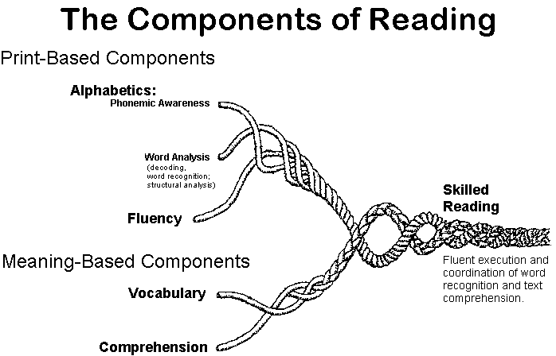

Slide 18
Teaching and reinforcing alphabetic skills in adult education classes is crucial for improving
fluency
vocabulary
comprehension
Many adult learners struggle with phonemic awareness and decoding, which hinders their overall literacy and progress in educational and workforce settings.

Slide 19
What are some objections to teaching alphabetics?
It’s too complicated.
I didn’t learn phonics as a child.
I don’t have time.
I don’t have the resources.
No one in our program is doing this.
I don’t know how to start.

Slide 20
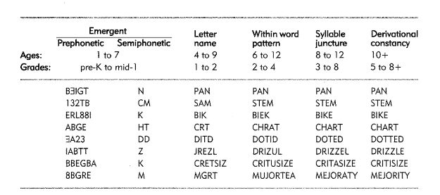
Learners fall into one of 5 spelling stages.
https://drive.google.com/file/d/0B2JElIpasttxMUQwVDR4VTNPZE0/view?usp=sharing&resourcekey=0-gCph-zGRMgyGxbCwP4mOBg

Slide 21
If you learn to determine what spelling stage your students are in and what concepts they are lacking, do you think you could teach them systematically?

Slide 22
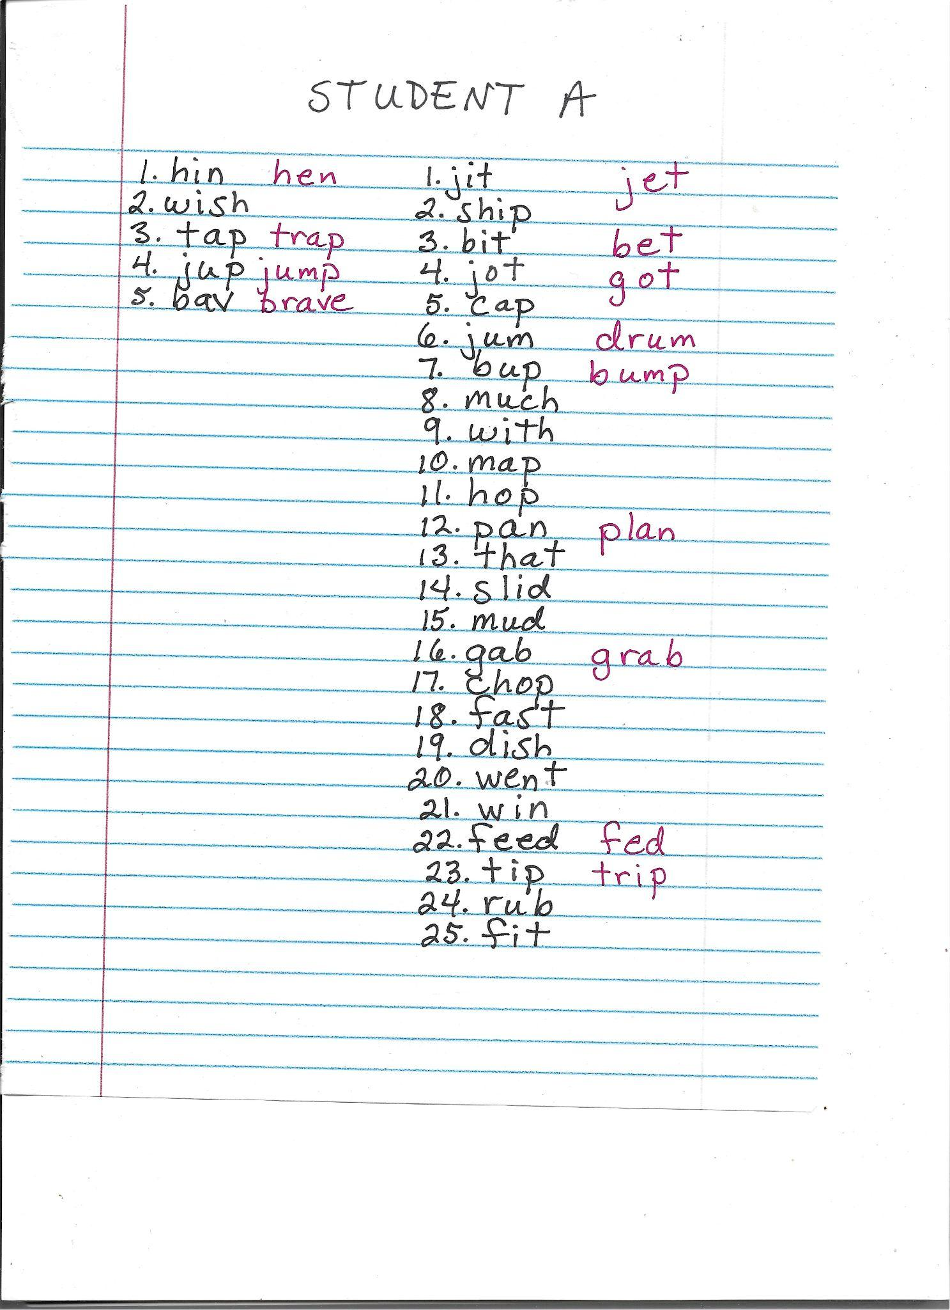
You can assess a student’s spelling stage with Kathy Ganske’s DSA (Developmental Spelling Analysis).
https://www.guilford.com/books/Word-Journeys/Kathy-Ganske/9781462512508

Slide 23
Systematic phonics instruction is the way.
What is “systematic” phonics instruction?

Slide 24
Systematic Phonics Instruction for Adult Struggling Readers
Definition: A structured approach to teaching reading that focuses on the relationship between letters and sounds.
Not as it comes up or “discoverable”.

Slide 25
Key Characteristics:
Explicit Teaching: Direct instruction on letter-sound relationships.
Example: Teaching how "th" makes a /th/ sound in "think."
Sequence and Structure:
Starts with simple sounds and letters.
Progresses from simple to complex patterns (e.g., CVC words, blends, digraphs).
Example: Moving from "cat" (CVC) to "jump" (blend) to "through" (digraph).

Slide 26
Practice and Application:
Writing & reading activities that incorporate learned phonics rules
Example: Reading a passage with targeted phonics patterns, then writing sentences using those words

Slide 27
Regular progress monitoring.
Tailored instruction based on student needs.
Example: Using diagnostic assessments to identify specific phonics gaps and providing targeted practice.

Slide 28
Typical scope of an alphabetics program
https://docs.google.com/document/d/1wF-Sau6wIGVtAL8PPPUNoJB3VqC2X858P8s147mySx8/edit

Slide 29
Words Their Way
Words Their Way incorporates analytic phonics in activities that ask students to compare and contrast known words, helping them discover patterns. For example, students might compare word families or groups of words with common spelling patterns (e.g., -ate, -ight) to analyze how similar phonetic elements appear across different words.

Slide 30
Let’s practice an easy way to get started with your students in a system of phonics, so you can start immediately!

Slide 31
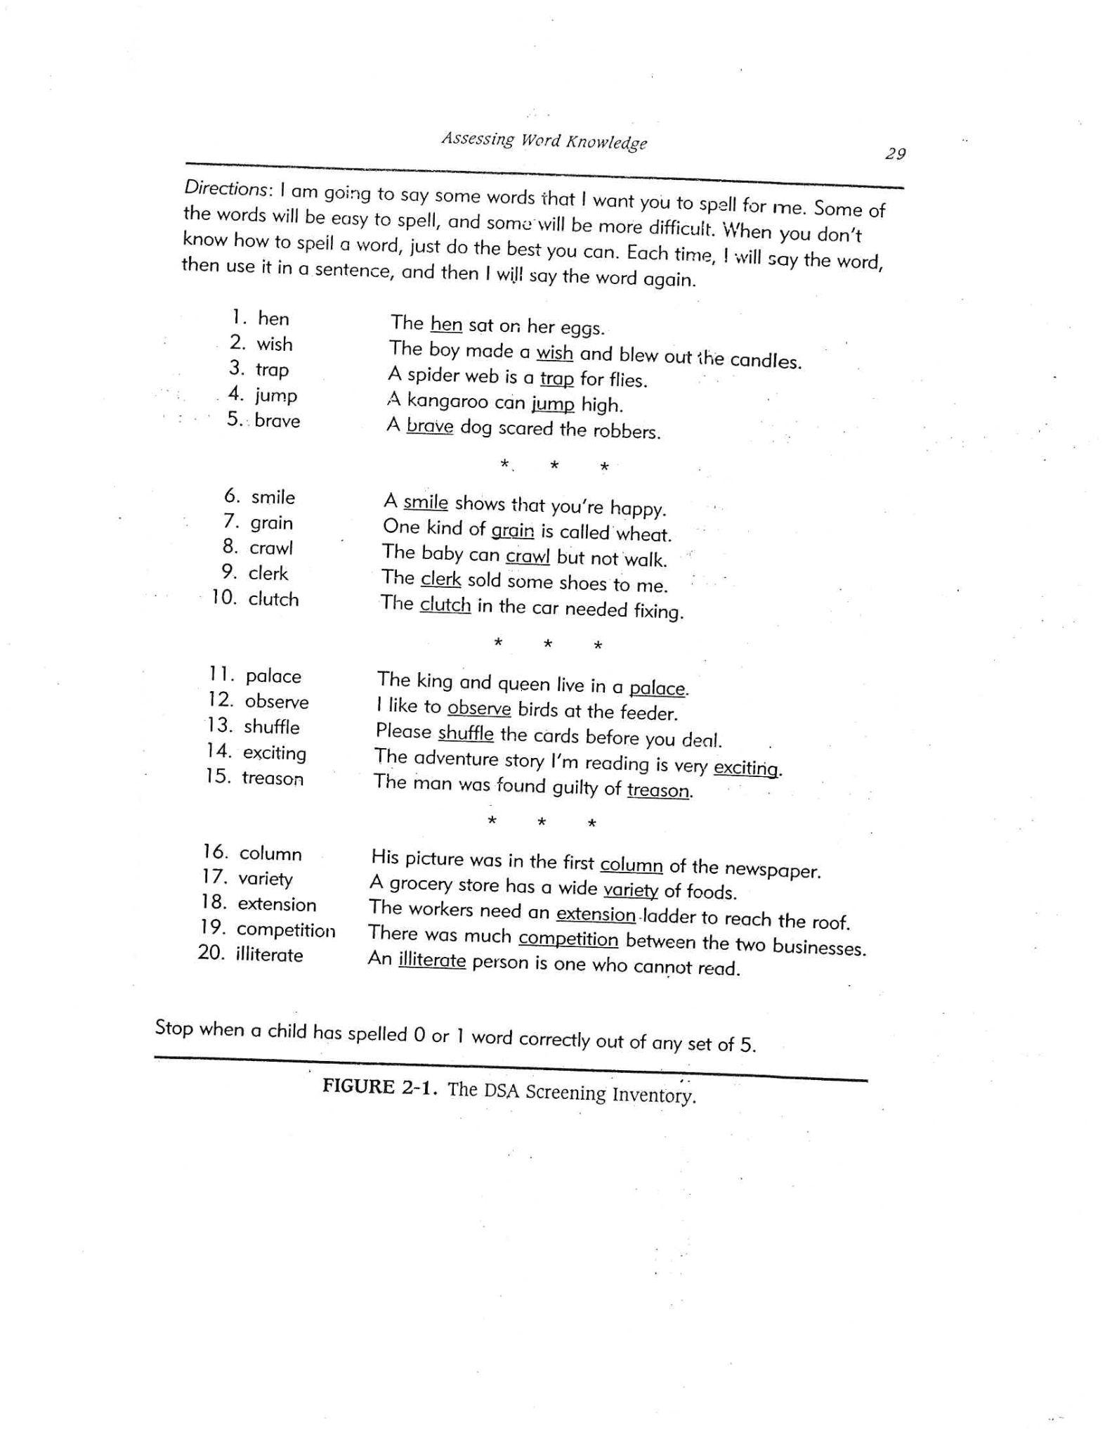
Find the DSA on your table
LN
https://drive.google.com/file/d/0B2JElIpasttxYWxGYWVzcy1KM1E/view?resourcekey=0-dBZbVwu0Q5RUi99Ax60qjg
WW
SJ
DC

Slide 32
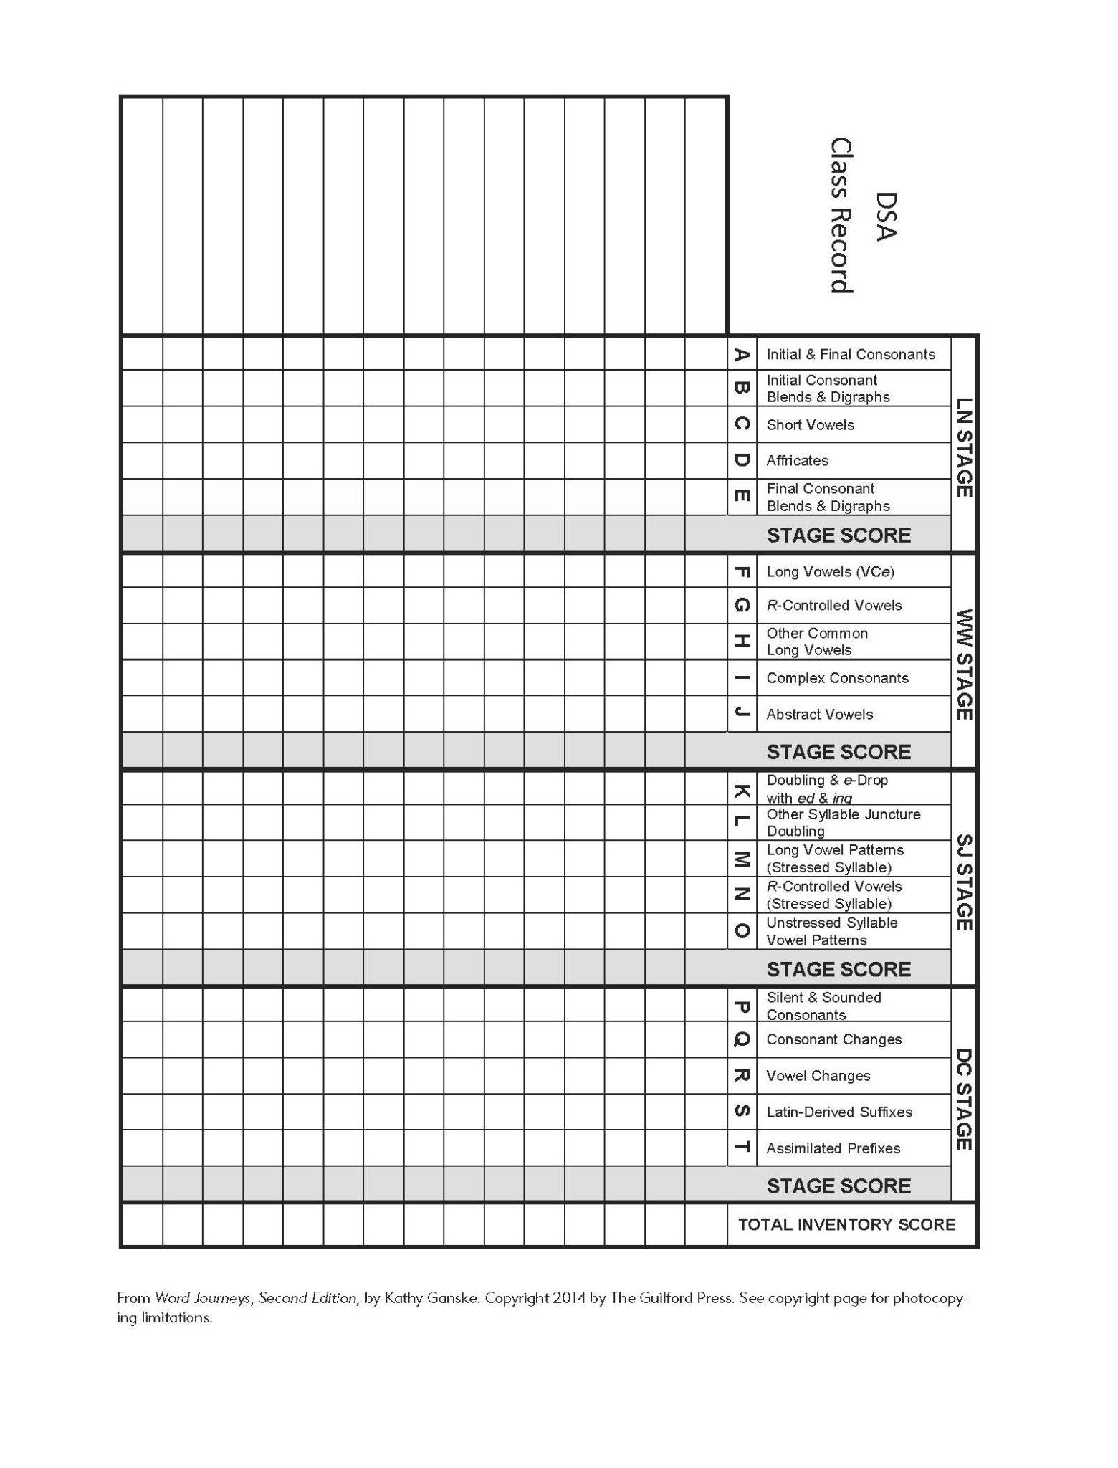
Find the DSA Class Record

Slide 33
The 3 stages we will focus on
Letter name
Within Word
Syllable Juncture

Slide 34
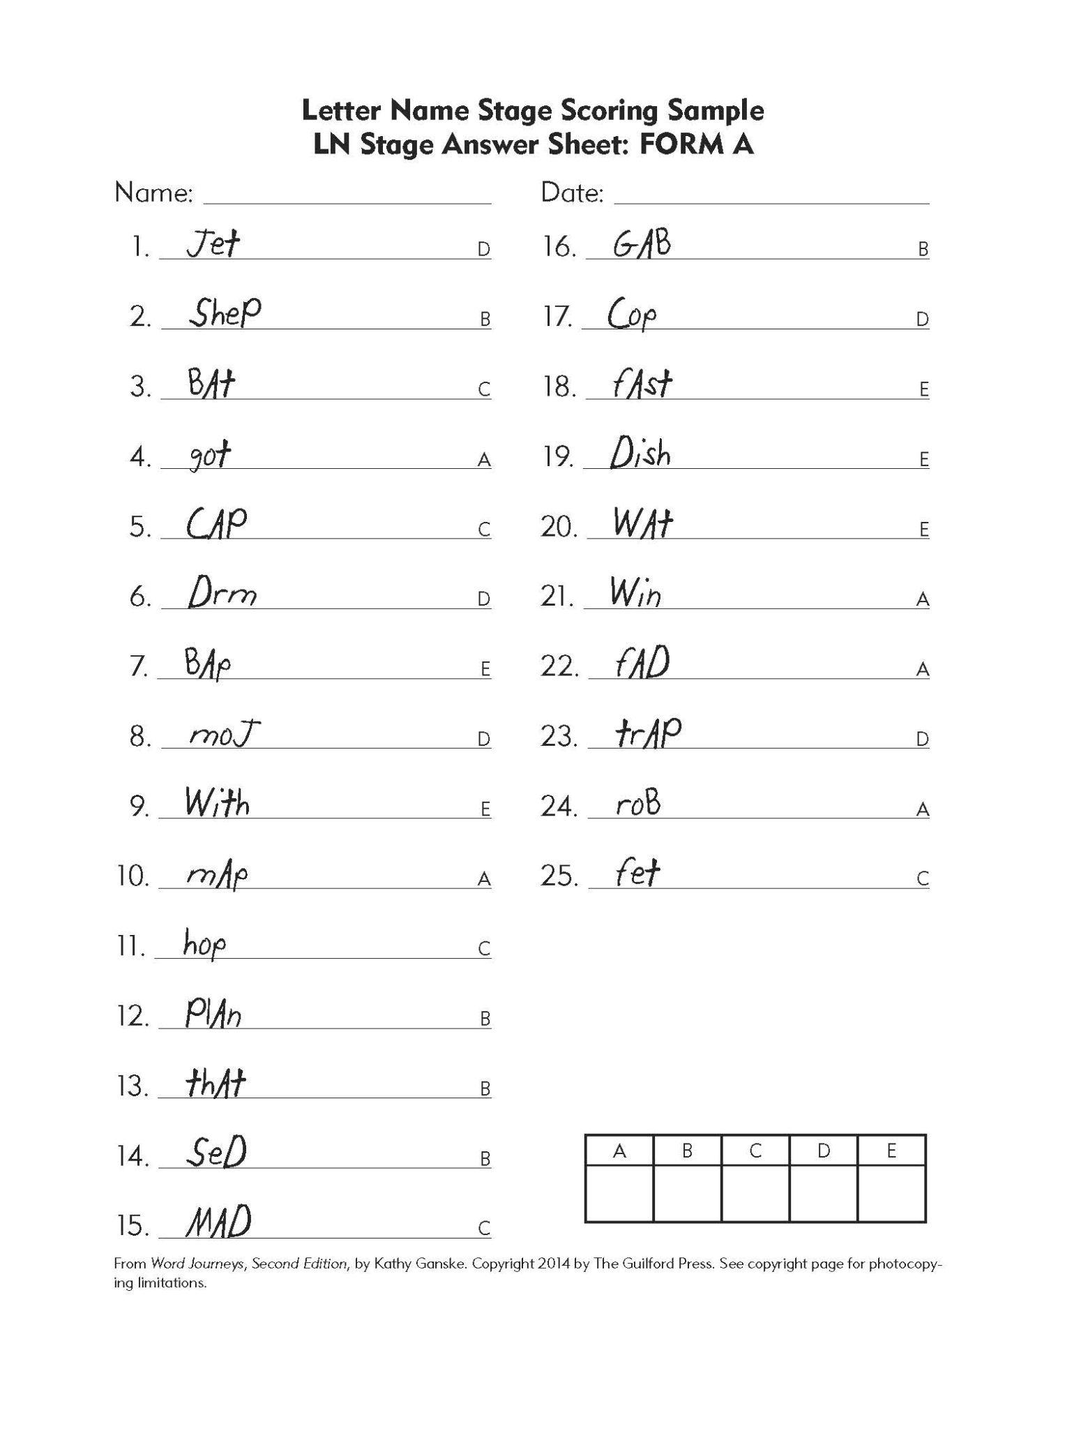
Find the Letter Name Stage Scoring Sample

Slide 35
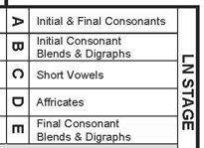
What errors do you see?

Slide 36
Ask ChatGPT to give you a Words Their Way or Word Journeys sort for [provide spelling error].
Prompt:
Give me a Words Their Way sort for this spelling error: rob for RUB. Give me at least 10 words per category.

Slide 37
For the spelling error "rob" for "rub," the student is likely struggling with differentiating between short vowel sounds, specifically the short "u" (/ʌ/) sound in "rub" and the short "o" (/ɒ/) sound in "rob." A Words Their Way sort can focus on words with short "u" vs. short "o" sounds to help students differentiate between these vowels.
Category 1: Short "u"
rub
cub
tub
hug
mug
sun
bun
fun
cut
bud
Category 2: Short "o"
rob
sob
job
cot
not
hop
top
dog
log
fog

Slide 38
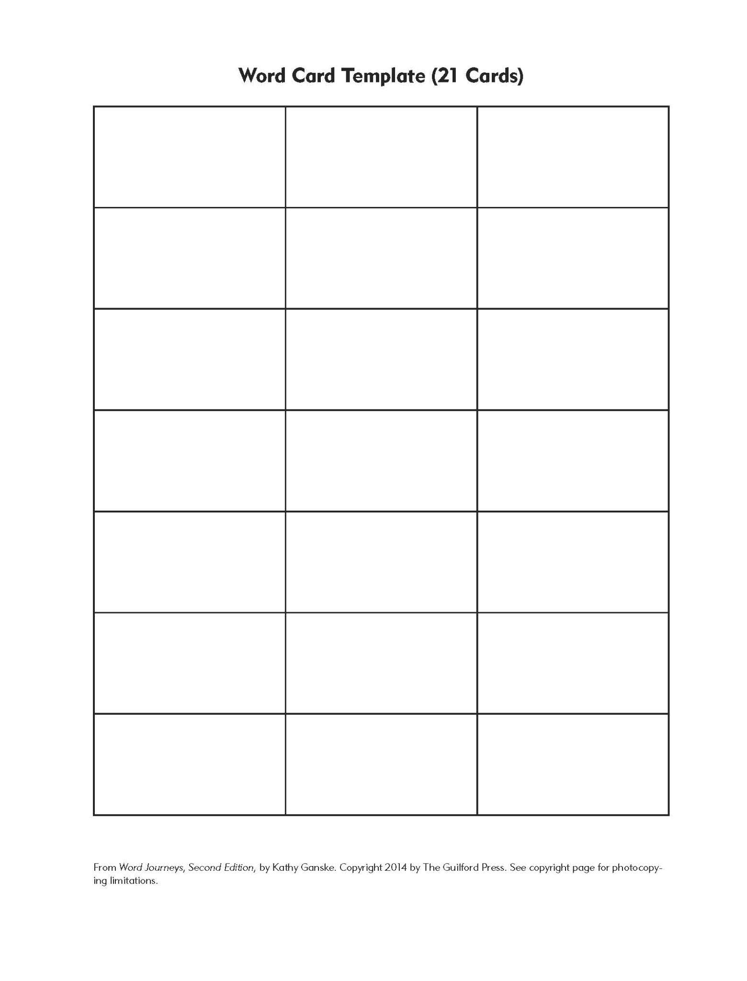
rob
rub
Headers in bold
and fill in with other words out of order.
hug
cot
bun
sob
mug
bud
top
dog
not
log
sun
fog
tub
nut
job
cot
fun
cub

Slide 39
Use AI to help with activities
“Give me two highly effective activities to use with adult students learning these words”
Results

Slide 40
Use AI to help with activities
“A student spells rob for RUB on a developmental spelling analysis. You are a reading specialist at an adult learning center. What activities would you provide that would include synthetic phonics?”
Results

Slide 41
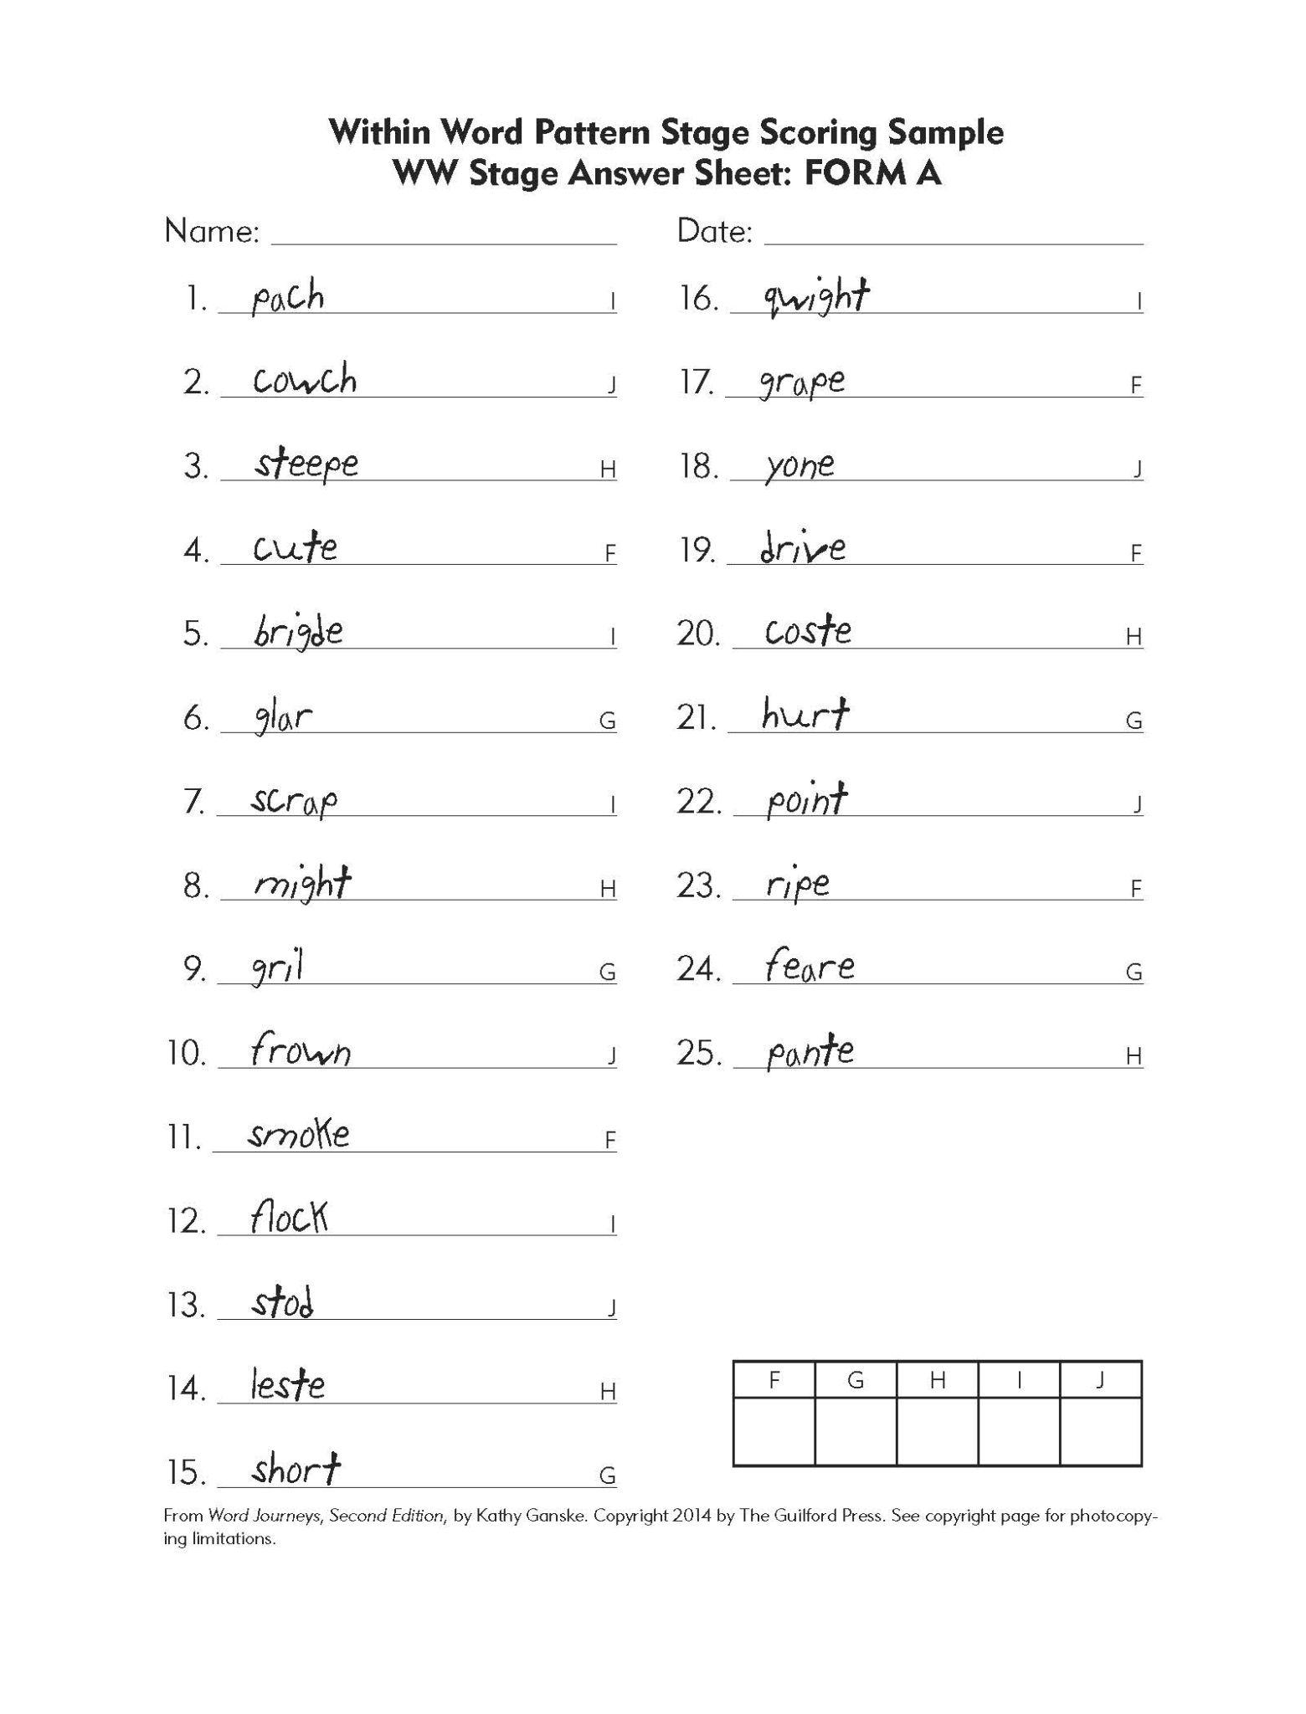
Find the Within Word Stage Scoring Sample

Slide 42
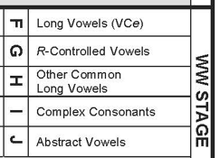
What errors do you see?

Slide 43
Ask ChatGPT:
Give me a Words Their Way sort for this spelling error: pach for PATCH. Give me at least 10 words per category.

Slide 44
Category 1: Words with "-tch" (after a short vowel)
patch
match
catch
hatch
watch
fetch
ditch
itch
pitch
batch
Category 2: Words with "-ch" (after a consonant or a long vowel)
lunch
bench
bunch
punch
branch
march
peach
reach
teach
coach
Category 3: Words with "-sh" (similar consonant sound)
fish
wish
push
crush
flash
brush
dash
trash
cash
clash

Slide 45
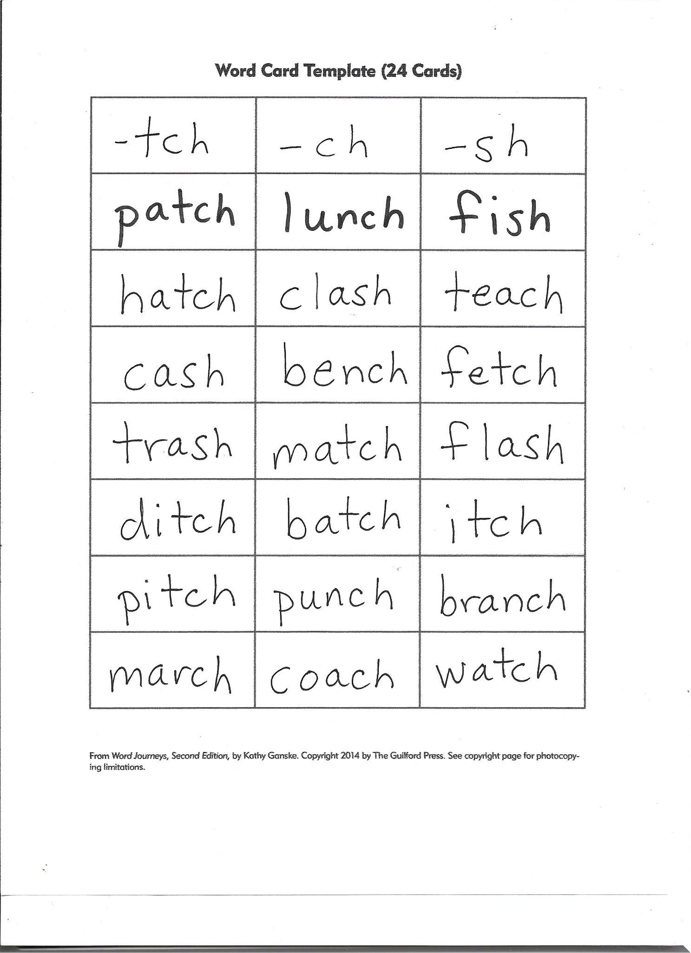

Slide 46
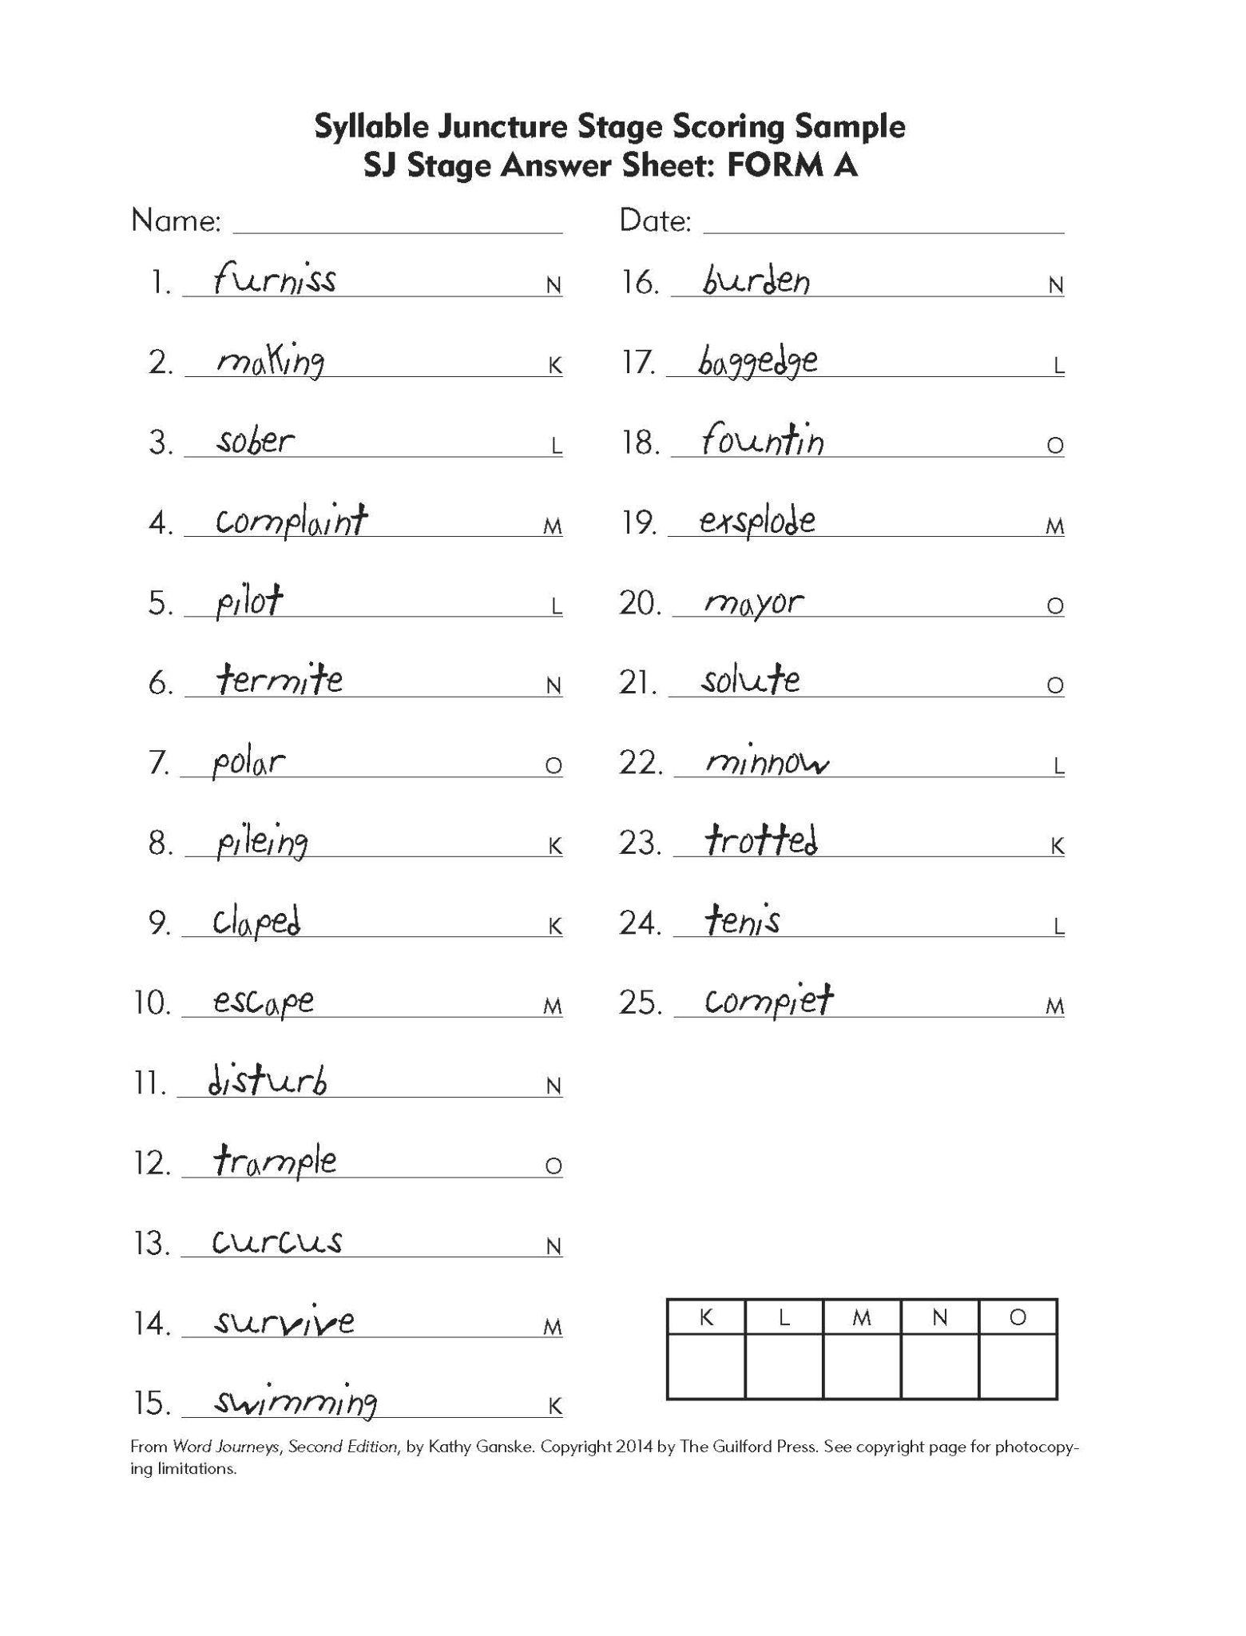
Find the Syllable Juncture Stage Scoring Sample

Slide 47
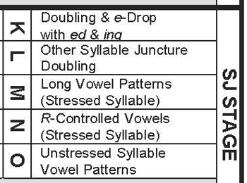
What errors do you see?
Unstressed syllable vowel patterns explanation

Slide 48
Ask ChatGPT
Give me a Words Their Way sort for this spelling error: pileing for PILING. Give me at least 10 words per category.

Slide 49
Here is the result from AI:
Category 1: Drop the Final "e" Before Adding "-ing**
piling (pile + ing)
hoping (hope + ing)
smiling (smile + ing)
hiking (hike + ing)
writing (write + ing)
baking (bake + ing)
coming (come + ing)
giving (give + ing)
living (live + ing)
driving (drive + ing)
Category 2: Keep the Base Word (No Final "e" to Drop)
running (run + ing)
sitting (sit + ing)
getting (get + ing)
hitting (hit + ing)
swimming (swim + ing)
planning (plan + ing)
jumping (jump + ing)
playing (play + ing)
flying (fly + ing)
bringing (bring + ing)
“You forgot to mention doubling.”

Slide 50
Category 1: Drop the Final "e" Before Adding "-ing
piling (pile + ing)
hoping (hope + ing)
smiling (smile + ing)
hiking (hike + ing)
writing (write + ing)
baking (bake + ing)
coming (come + ing)
giving (give + ing)
living (live + ing)
driving (drive + ing)
Category 2: Double the Final Consonant Before Adding "-ing" (VC Pattern)
(These are one-syllable words with a short vowel followed by a single consonant.)
running (run + ing)
sitting (sit + ing)
getting (get + ing)
hitting (hit + ing)
swimming (swim + ing)
planning (plan + ing)
jogging (jog + ing)
dropping (drop + ing)
stopping (stop + ing)
clapping (clap + ing)
Category 3: Keep the Base Word (No Final "e" or Doubling Required)
playing (play + ing)
flying (fly + ing)
going (go + ing)
raining (rain + ing)
looking (look + ing)
feeling (feel + ing)
seeing (see + ing)
meeting (meet + ing)
hearing (hear + ing)
needing (need + ing)

Slide 51
“Can you create a downloadable worksheet for students to practice these words? You can choose any type of worksheet you want.”
RESULTS

Slide 52
“Give me another one that is different and engaging.”
RESULTS

Slide 53
Why use this system DSA + AI?
easy to get started
Immediate and long-term benefits for student reading outcomes

Slide 54
There are lots more resources for teaching alphabetics
https://atlasabe.org/resource/e-advanced-alphabetics/

Slide 55
Morpheme matrices
https://drive.google.com/file/d/1i7QyHboVatzHJRrUGOVW93bdzqZOT9nr/view?usp=sharing

Slide 56
Ask ChatGPT to help create sentences:
Create ten sentences using these words where the theme is anger management. Must be at a 5th grade reading level for adults.
remit, submit, transmit, remits, remitted, remitting, remitter, remittable, remittal, submits, submitted, submitting, submitter, submittal, transmits, transmitted, transmitting, transmitter, transmittal, dismiss, remiss, dismisses, dismissed, dismissing, dismissible, dismissal, remission, remissible, submission, transmission, transmissible

Slide 57
AI-created sentences
When you feel angry, it's important to submit to calming techniques, like taking deep breaths.
If you transmit your frustration to others without thinking, it can hurt their feelings.
Sarah dismissed the idea of yelling as a way to deal with her anger and chose to talk instead.
Submitting to your anger without trying to control it can lead to more problems later.

Slide 58
Project read
https://www.projectread.ai/
Generate unlimited stories from any supported curriculum
Edit, share, and download generated stories
Customize objectives, adjust story length, and select focus areas
Personalize stories with custom words and names
Unlock full access to chat with Lola, our SoR chat-bot (beta)
Try our AI Tutor by sharing story codes with your classroom

Slide 59
Citizen Literacy
https://citizenliteracy.com/app/

Slide 60
DIFFIT
https://app.diffit.me/

Slide 61
DSA + AI is easy to adopt, and doesn’t take much time!
Teacher-led phonics sessions are only 5-15 minutes
The majority of a class session should involve learners reading and discussing interesting texts.

Slide 62
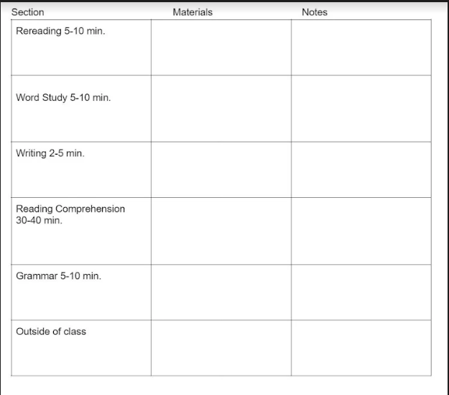
Now that we've seen how these methods work, let’s talk about how you can start using them in your classroom tomorrow.

Slide 63
Onwards!
Can you see how peer observations with the EBRI observation tool could improve your team’s reading instruction?
Can you see how a single spelling test + AI can help you teach individualized phonics?
I would love to hear if you use some of these ideas!
mora.dasilva@southside.edu
Connect with me on LinkedIn - Mora da Silva

Slide 64
EBRI and Alphabetics Resources
Resource folder: http://tinyurl.com/SciOfReadingResources

Slide 65
BONUS: teaching large groups
Tip for large groups:
Give everyone the full screening on one day.
After class, decide on what stages to assess the next day. Assess all your LN in at one time in one group, move to WW for the next group, and so on.
You can also teach in stage groups.

Slide 66
BONUS: what to do with oddball words that do not follow the expected pronunciation-create an “oddball” category
Category 1: "ai" (as in "rain")
rain
train
pain
mail
brain
Category 2: "a_e" (as in "lane")
lane
cake
bake
plate
name
same
Oddball
said

Slide 67
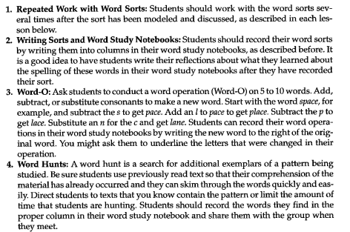
Words Their Way activities

Slide 68
